Slide 1
STUDENT QUERIES SOLVING SYSTEM
PROJECT GUIDE:
Mr.M.Prasanna Kumar
TEAM MEMBERS:
Merlin Jone. J
(810019205062)
Yahavarshini. E
(810019205110)

Slide 2
1. Introduction:
In general, higher education institutions lack a specific student query system. Even though they have a distinct committee for student inquiries, getting in touch with them is difficult. We've put this process online to make it as simple as possible. Solving queries from leads and applicants can be a nightmare if you are not equipped to centralise them for multichannel support. A manual data entry or a siloed departmental process makes it worse. NoPaperForms’ Centralised Query Solving System offers a lightning fast way to reach out to your prospects Especially to guide fresher’s, we going to develop a web application called Student Query Solving System (SQSS). Student query solving system is a web application which also includes chatbot that tracks all of a student's troubles from day one to the completion of his/her course and may be used for all reporting purposes. The main algorithm that's used for making chatbots is the “Multinomial Naive Bayes” algorithm. It is used for text classification and natural language processing (NLP). The user will receive an automatic noreply email as a response. In order to assist the anti-raging committee, we also categorize raging issues. The queries we receive in categories will be forwarded to the concern committee/authority as a notification mail for further action. The feeeback included to get valuable feedback from students. The candidates can rate the support received with a positive or a negative feedback and you can always reach out to them to understand their concerns better. This also helps you keep a track of how well you understand the type of student queries.

Slide 3
LITERATURE SURVEY:
S.NO | TITLE OF THE PAPER | AUTHORS | ABSTRACT
1 | Improving educational web search for question-like queries through subject classification | Tolga Yilmaz, Rifat Ozcan, Ismail Sengor Altingovde, Özgür Ulusoy. | First implement a classifier for educational questions. This classifier is built by an ensemble method that employs several regular learning algorithms and retrieval based approaches that utilize external resources and also build a query expander to facilitate classification.
2 | The use of an Online Student Query System using an ITIL approach at CPUT, Department of Information Technology | Waldon Hendricks , W Hendricks | Student’s queries play a significant role in improving the service delivery for IT students at CPUT Department of Information Technology. It is imperative to know how to handle student requests efficiently. Currently student’s lodge their complaints, selecting from a list of topics their query gets captured, the student query might not get addressed on time or in a certain time frame to support ITIL-based continual service improvement.
3 | Computer System, Data Management with Query Manager: Case Study for Query of the Students and Universities | Deepswariya Babu, Ayush Poddar, Neeraj Yadav | Student query System provides an interface for smooth response and maintenance of student query. University can use this for maintaining the data of the students in an easy manner. The conduction of accurate and updated data to a student’s query is critical and equally important in the educational institution towards academics, examination, and even general information
4 | A Literature Survey on Automatic Query Expansion for Effective Retrieval Task. | Jagendra Singh, Aditi Sharan, Sifatullah Siddiqi | This paper presents a survey of important work done on automatic query expansion. Automatic query expansion is the process of automatically supplementing additional terms or phrases to the original query and is considered an extremely promising technique to improve the retrieval effectiveness
5 | Handling e-complaints in customer complaint management system using FMEA as a qualitative system. | Alireza Faed | Negative customer perception often manifest as formal companies; while unknown percentages do not become so visible. Within a customer complaint management system, it is possible through careful analysis to identify the flaws in the service standards, in the complaint handling procedure itself, and the finer points which help to formulate resolution methods.
6 | An analysis of online customer complaints: implications for Web complaint management. | Yooncheong Cho, Il Im, R. Hiltz, Jerry Fjermestad. | provide excellent online customer services because customer service is the most important factor in online customer satisfaction. respond to customers' requests/complaints quickly because the response speed is more important in online customer satisfaction than offline. and employ strategies that are appropriate for the product category in question.

Slide 4
3. PROPOSED SYSTEM:
The Query Solving Services is to replace the existing manual system with a software solution(Web application). Solving queries from leads and applicants can be a nightmare if you are not equipped to centralise them for multi-channel support. A manual data entry or a siloed departmental process makes it worse. NoPaperForms’ Centralised Query Management System offers a lightning fast way to reach out to your prospects When the student post a question or share about the issues, they have faced that can be solved by using past data’s or valuable solution by some other authorities by indicating them by Notification . We also include chat bot to assist the FAQ questions.
Advantages:
Faster processing when compared to existing one.
Maintaining frequently asked questions.
Modifications of answers can be carried out immediately.
Administrator can handle more number of students.

Slide 5
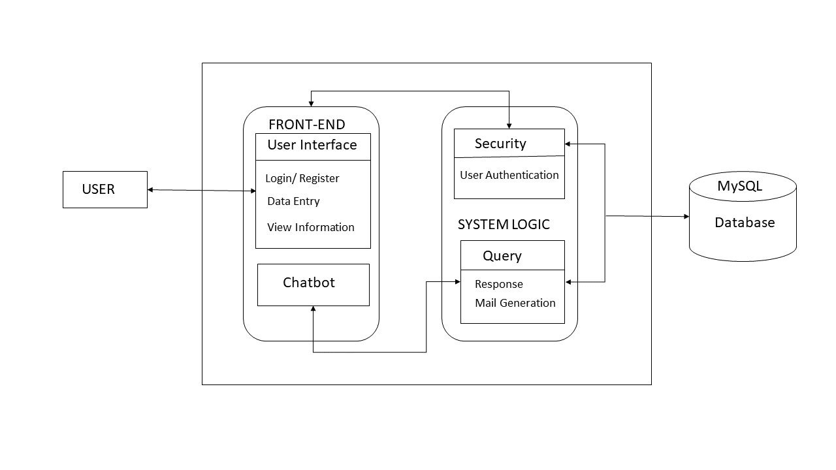
4.1 SYSTEM ARCHITECTURE DIAGRAM:

Slide 6
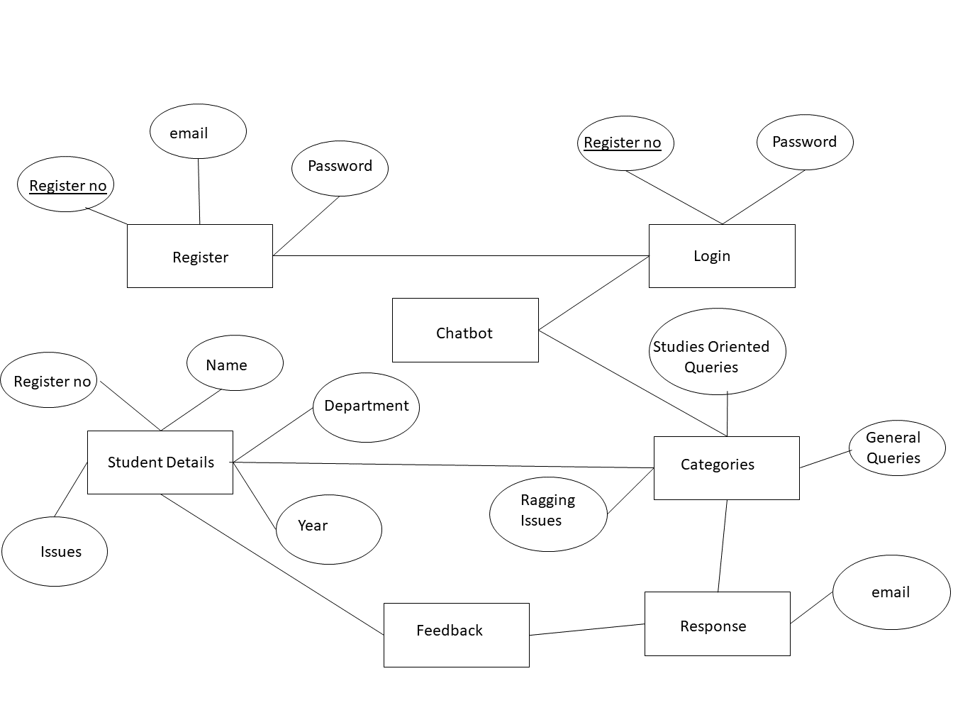
4.2 ER DIAGRAM:

Slide 7
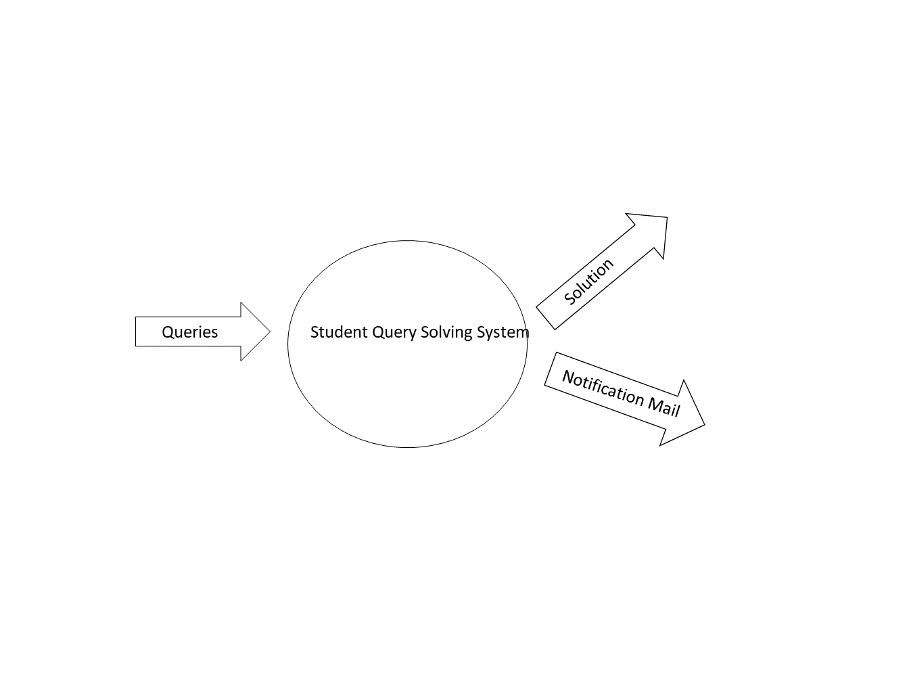
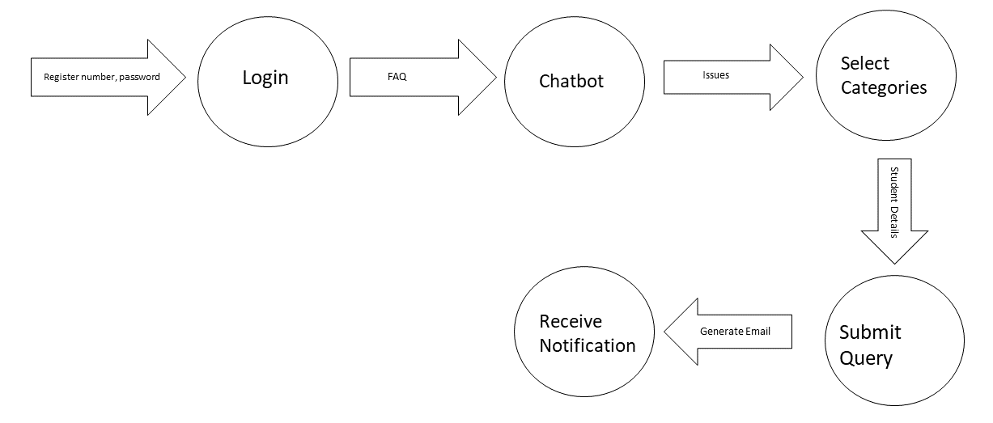
4.3 DATA FLOW DIAGRAM:
0th LEVEL:
1st LEVEL:

Slide 8
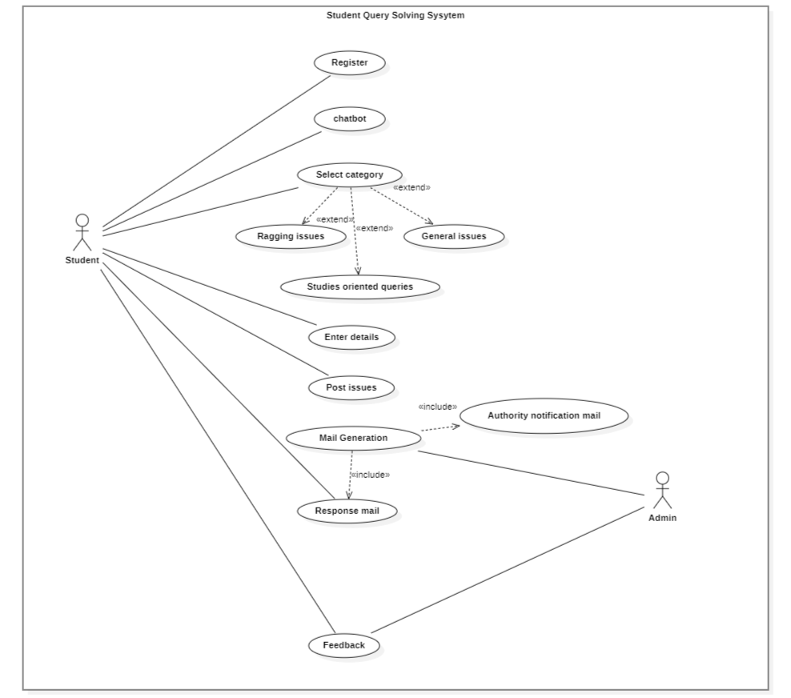
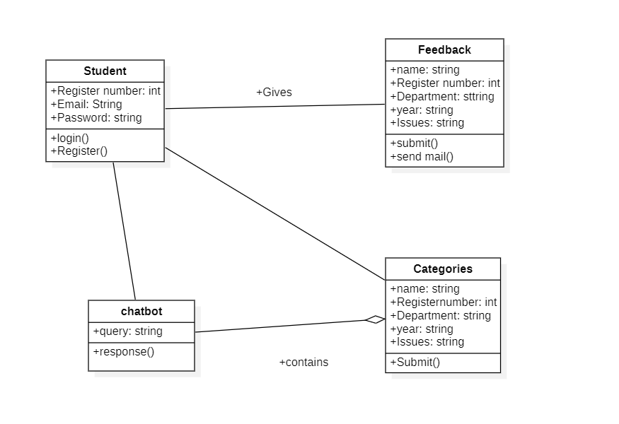
4.4 USECASE DIAGRAM:
4.5 CLASS DIAGRAM:

Slide 9
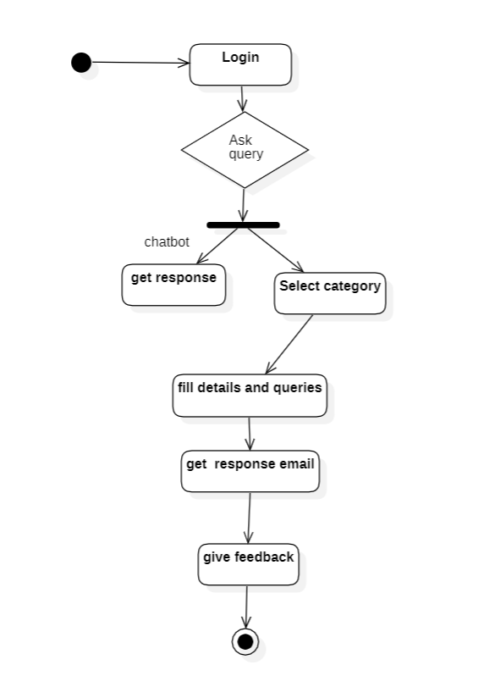
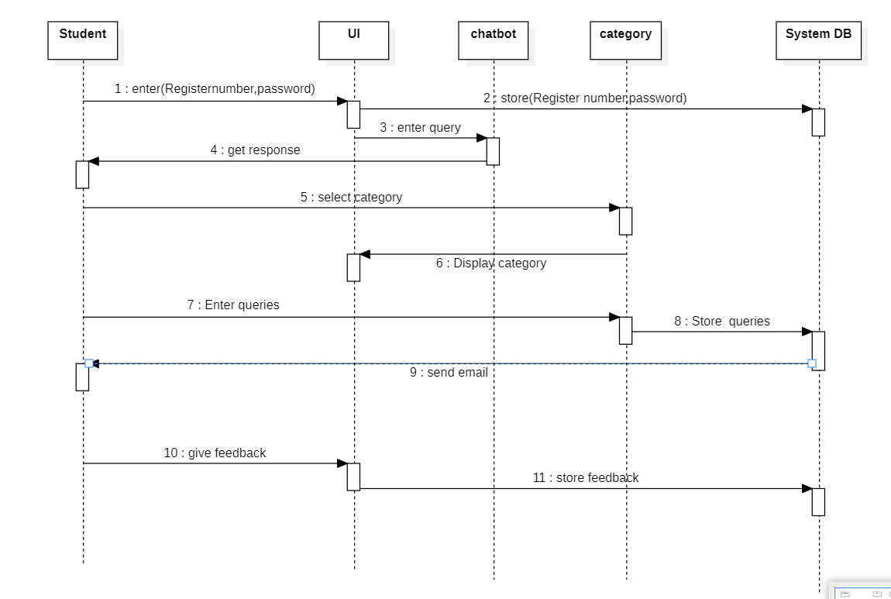
4.6 ACTIVITY DIAGRAM:
4.7 SEQUENCE DIAGRAM:

Slide 10
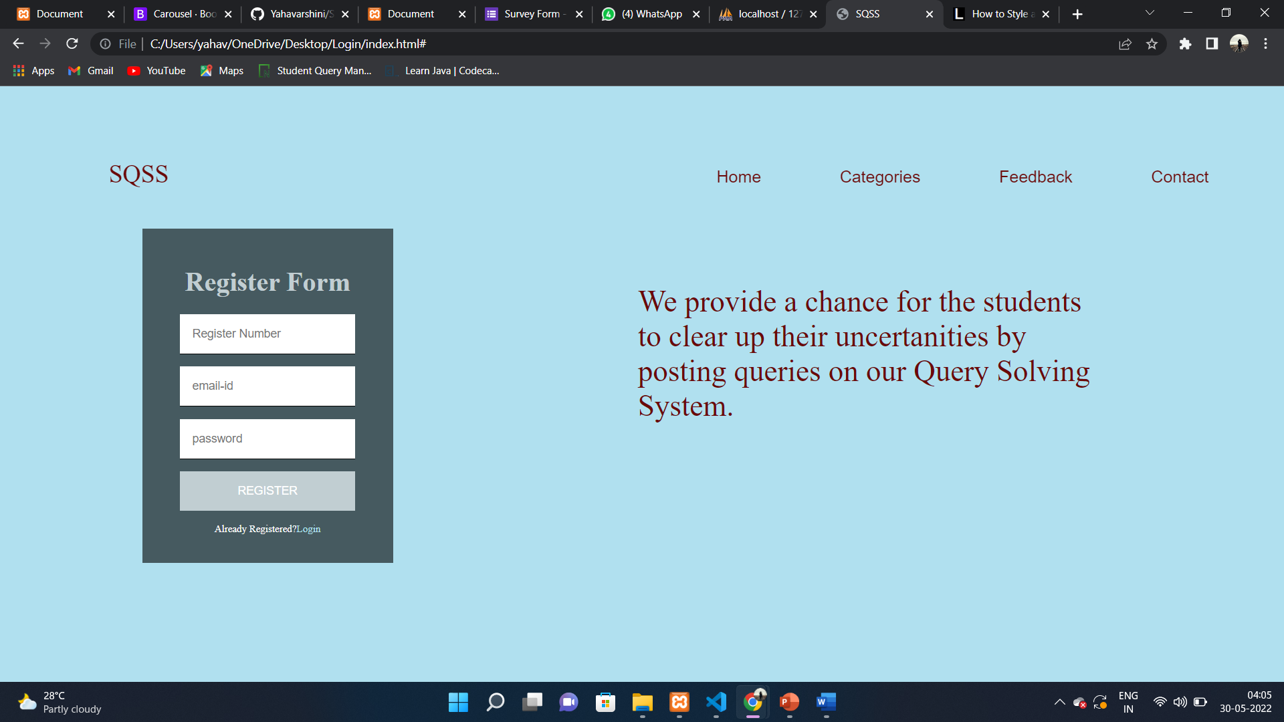
5. MODULE IDENTIFICATION:
Registration & Login Module
Chatbot
Categories
Feedback
5.1 MODULE I:
This provides an interface that restrict an unauthorized user from accessing the application, its objective is to validate and authenticate a user before granting access to him/her based on his/her access level (i.e. Student/Administrator) so as to access different aspect of the application, depending on their privileges defined by the application. It also allows new students that have being created by the administrator to register and use the application.
Input: Register Number, Email, Password
Output: Success or Failure

Slide 11
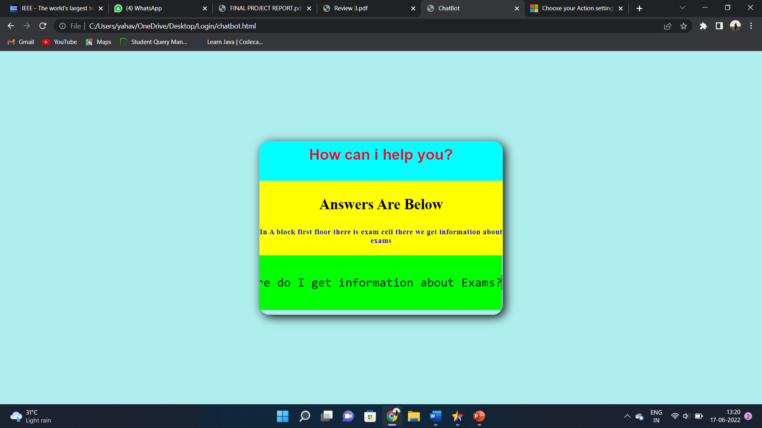
5.2 MODULE II:
Designed to convincingly simulate the way a human would behave as a conversational partner. A chatbot is a type of software that can help customers by automating conversations and interact with them through messaging platforms.
Input: Frequently Asked Questions
Output: Relevant Answers

Slide 12
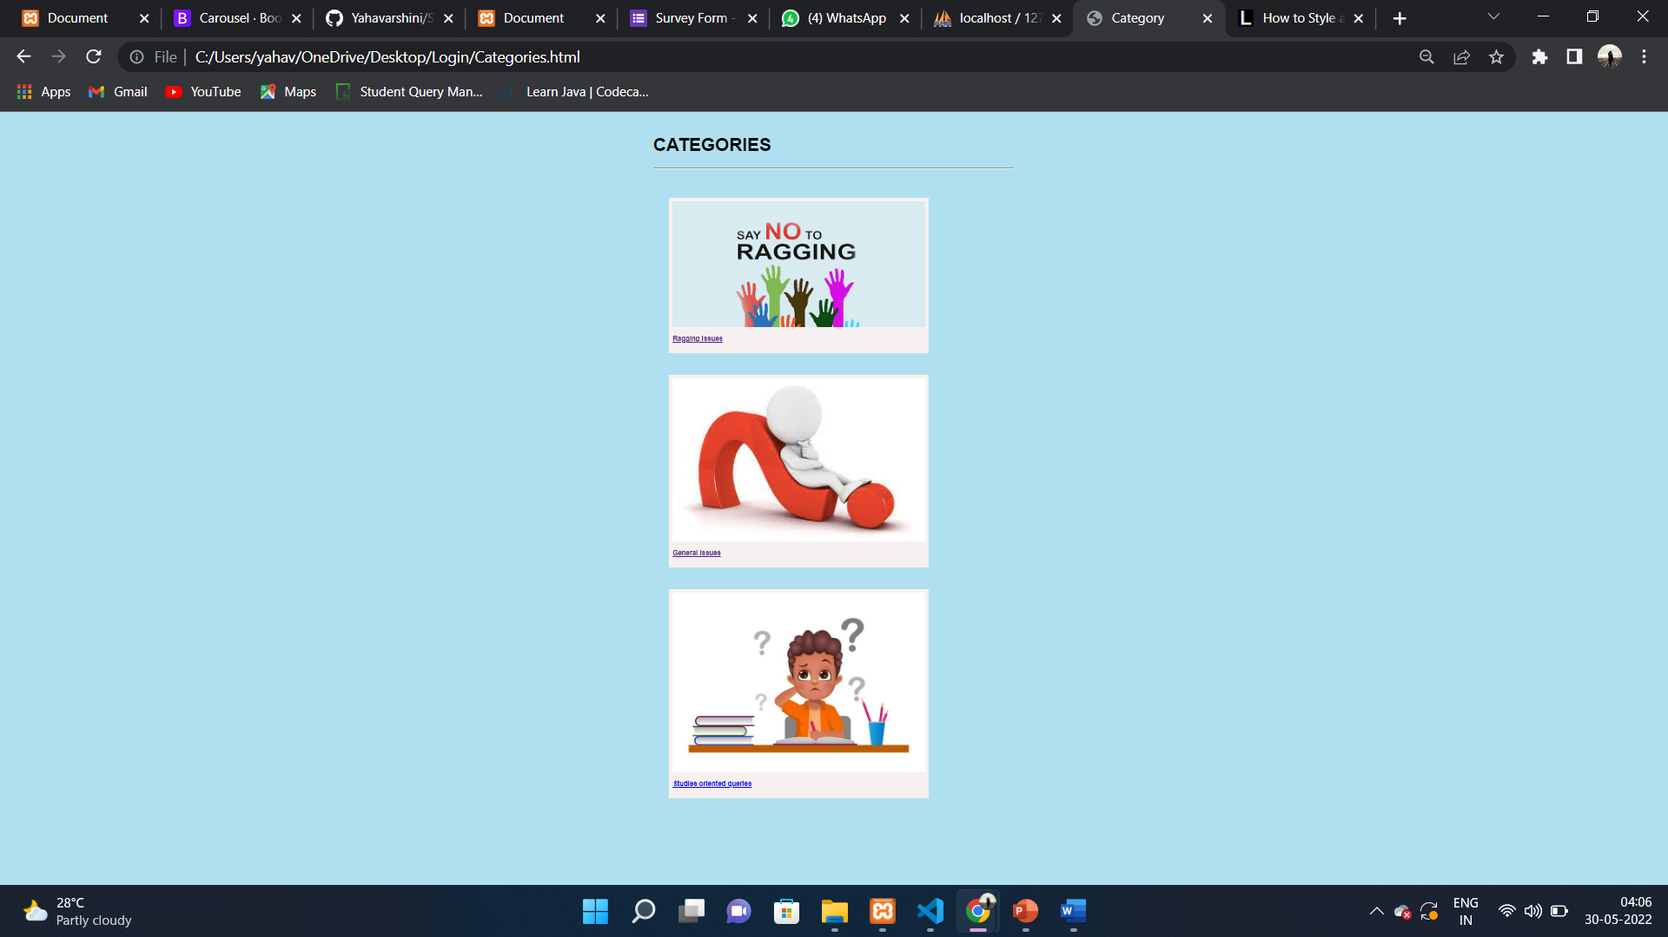
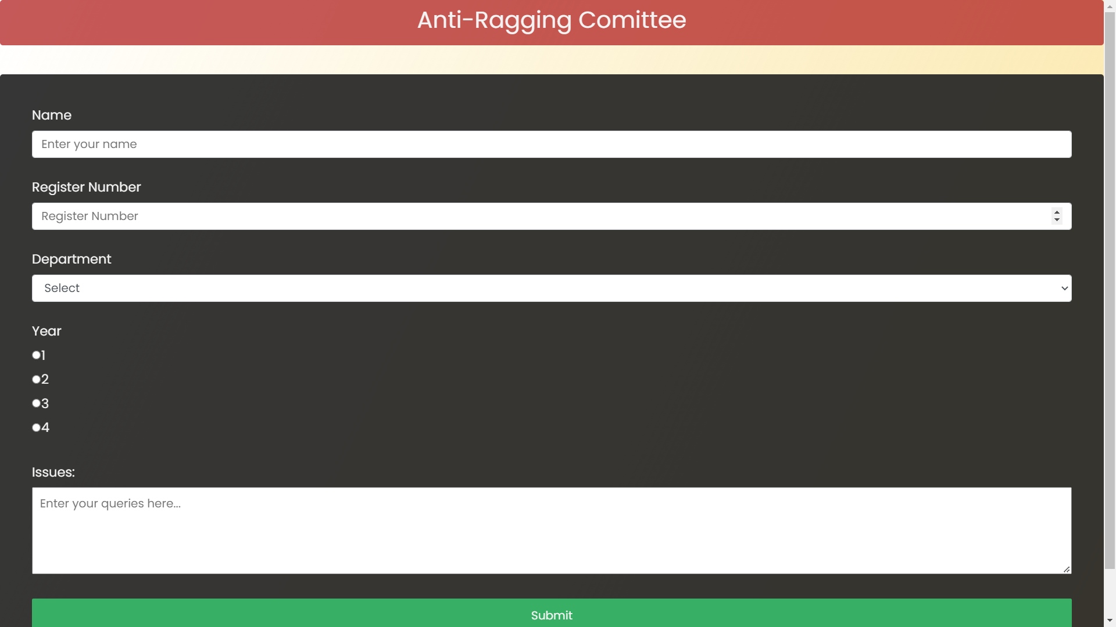
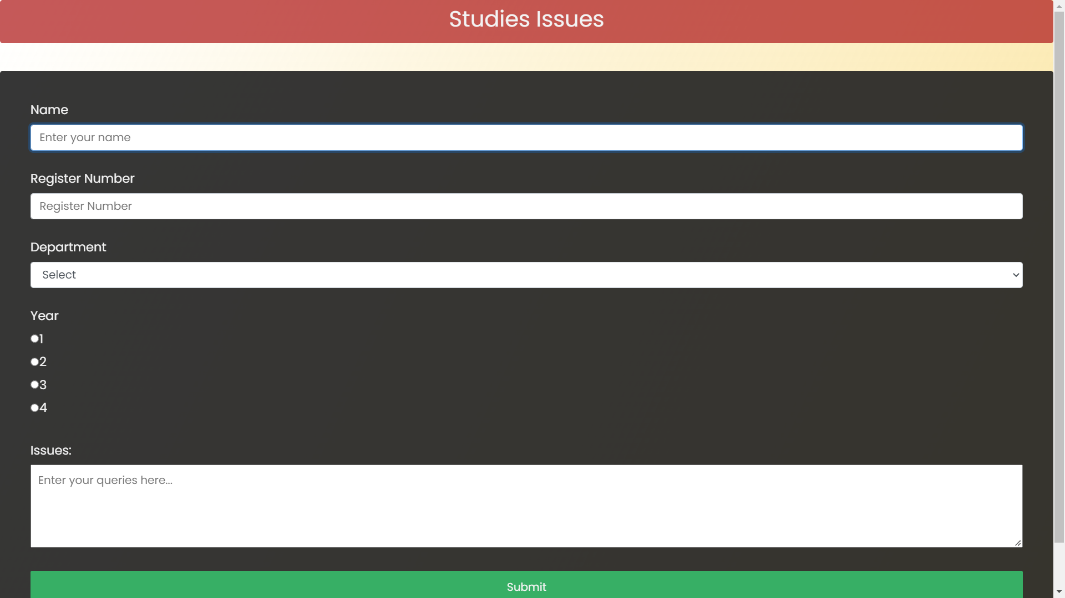
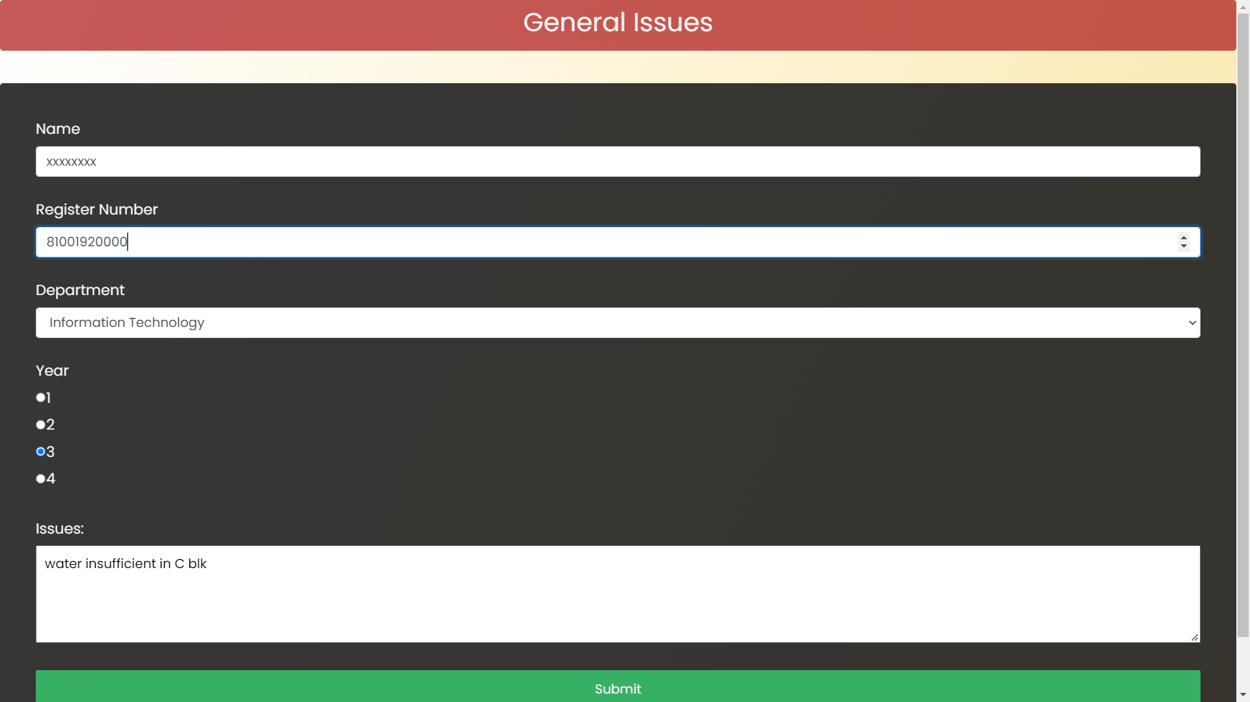
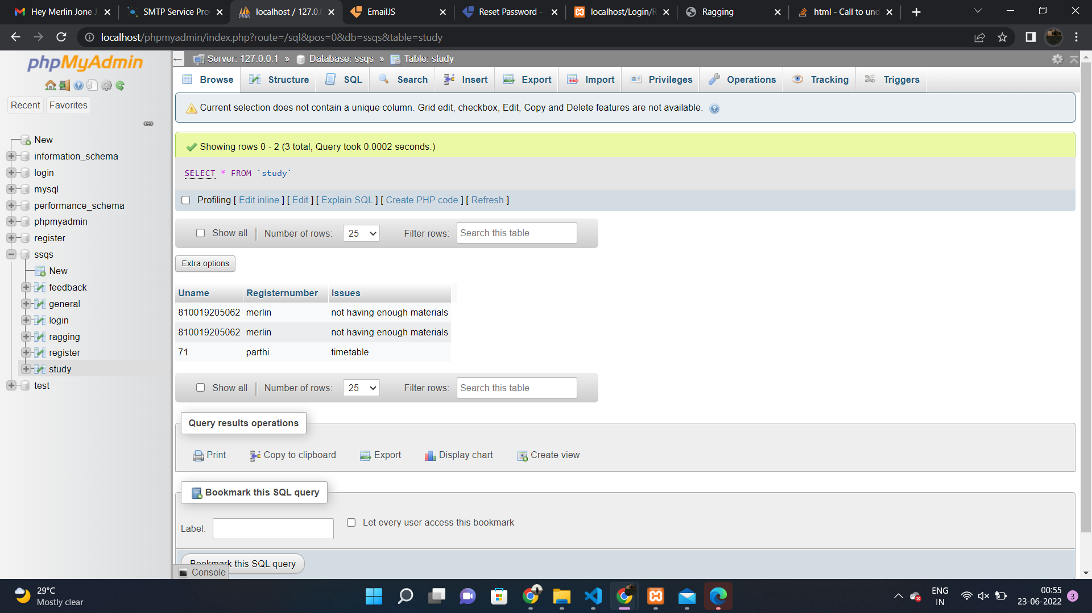
5.3 MODULE III:
Categories group individual Web pages together based on a similar subject or theme. It organize the content in a way that should make it easy for the user to find what he or she is looking for, and category pages serve as an index of all the pages and posts that belong to that particular subject.. in student query solving system we have 3 categories they are Ragging issues , general issues, studies oriented issues.
Input: Student Details, Issues
Output: Store in DB

Slide 13
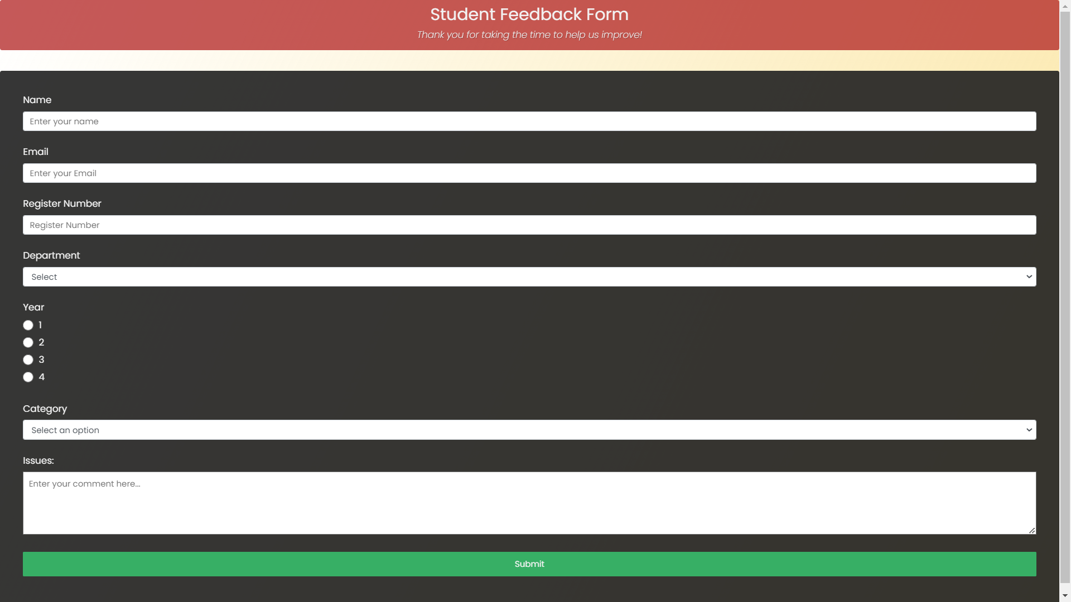
5.4 MODULE IV:
Feedback The candidates can rate the support received with a positive or a negative feedback and you can always reach out to them to understand their concerns better. This also helps you keep a track of how well you understand the type of student queries.
Input: Student Details, Feedback
Output: Stored in DB

Slide 14
6. CONCLUSION & FUTURE WORK
Conclusion :
Advancement in technology is making automation of mechanical activities become a very important aspect of our daily lives. Since the use of computers is now widespread, the adoption of this system will make life become easier for us all. Student Query Solving System designed for Students that they can ask any difficulties or queries at any time to system and can get the reply from chatbot / concerned authorities as soon as possible .
Future Work :
Multilingual & voice Bot. o
Improved UI.
Improved Security.

Slide 15
7. REFERENCE:
TolgaYilmaz, Rifat Ozcan, Ismail Sengor Altingovde, ÖzgürUlusoy , Improving educational web search for question-like queries through subject classification , Information Processing & Management , Volume 56, Issue 1,2019.
Waldo Hendricks1 and W Hendricks2 1Affiliation not available 2Faculty of Informatics and Design, Cape Peninsula University of Technology June 25, 2021
DeepswariyaBabu1, Ayush Poddar2, Neeraj Yadav3 1 -3Student, Dept. of Computer Science and Engineering, LPU, Punjab, India.
Jagendra & Sharan, Aditi & Siddiqi, Sifatullah . (2013). A Literature Survey on Automatic Query Expansion for Effective Retrieval Task. International Journal of Advanced Computer Research. 3.
A Faed , "Handling e-complaints in customer complaint management system using FMEA as a qualitative system," 2010 6th International Conference on Advanced Information Management and Service (IMS), 2010, pp. 205-209.
Yooncheong Cho, Il Im, R. Hiltz, Jerry Fjermestad, An analysis of online customer complaints: implications for Web complaint management.

Slide 16
Thank You

